Slide 1
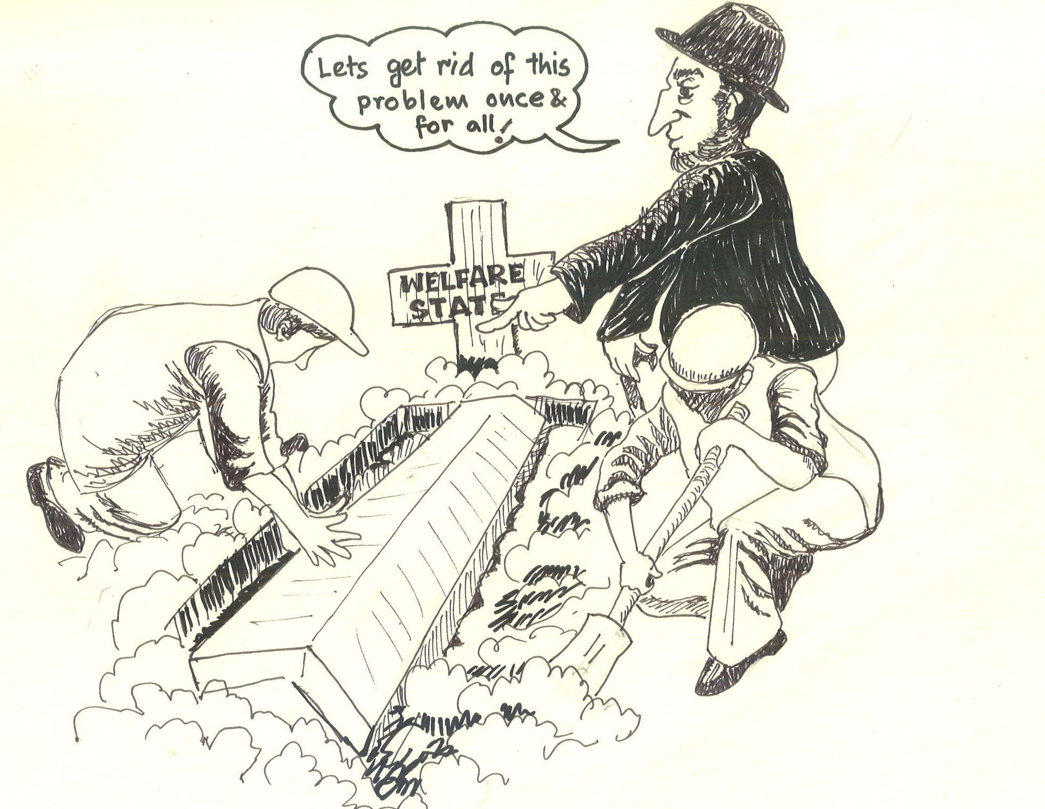
Universal Health Coverage: a panacea to Neo-liberal reforms or a repackaging of expired medicines?
Indranil, JSA-Delhi
AIPSN National Convention
Hyderabad, 21-22 December, 2019

Slide 2
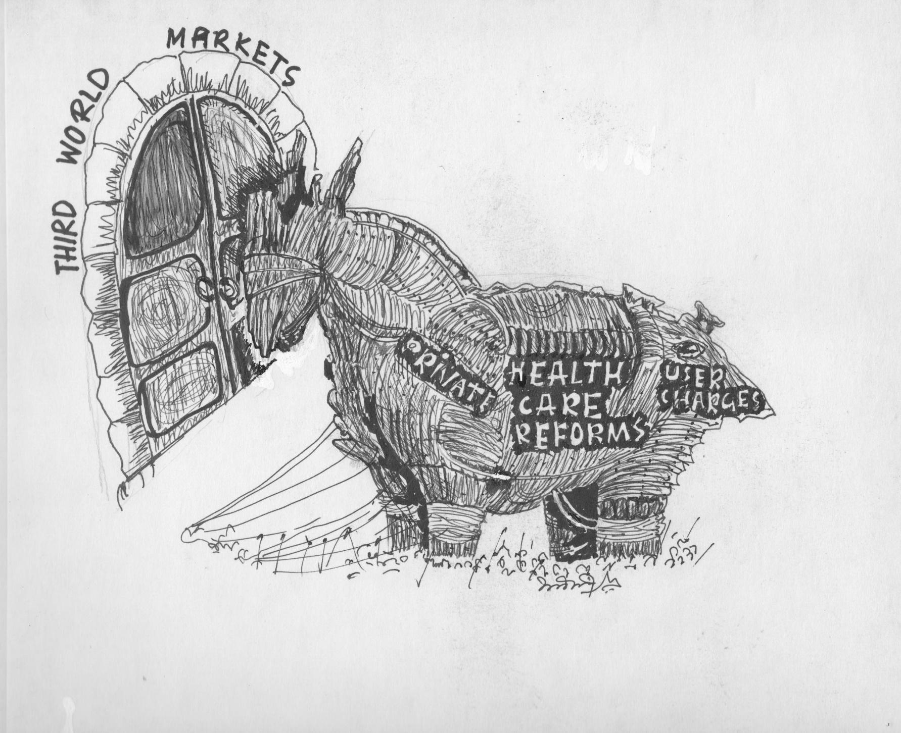
Contours of Neo-liberal Reforms
Macro Stabilisation
  Reducing the role of state
  Contractionary macro policies
  Curbing fiscal deficits
Structural Adjustments
  ‘Efficiency’ in resource mobilisation and allocation
  Introduction of market principles
  Trade Liberalisation
Health Sector Reforms
  Changes in the financial management
  Changes in the organisational management-New public management; public private partnerships
  Changes in the priority setting mechanisms- selective primary level care

Slide 3
Neo-liberal vision of Health
Market: Pareto Optimality-Price mechanism: exclusion; revealed preference
Market failure: non-rivalry, externalities; non-excludability
Pure public good- immunisation, preventive services etc… rest are private?
Fragmentation of health services: public and private
Information asymmetry, over consumption; inequality- Merit good
Capability & Justice

Slide 4
Nature and scope of health sector reforms
Changes in financing mechanisms: a shift in balance between the respective shares of tax revenue, social or private insurance, user fees and external aid in financing the health sector.
Changes in priority setting mechanisms, resulting in a shift in the range of services provided in the public and private sectors and the mechanisms through which they are financed.
Changes in organisational mechanisms: principally, a shift in the role of the state in the regulation and provision of health care services, usually in the direction of taking less responsibility for direct provision of health care and more responsibility for regulation.
Experimentation with various types of public-private partnerships: New Public Management
Accompanying changes in organisational mechanisms have included decentralisation, integration of services, including sector-wide approaches and reforms in logistics and supply systems.

Slide 5
Implications of HSR on peoples’ health
Cuts in public spending
Virtual stagnation of expansion of health facilities
Freeze in recruitments resulting in huge vacancies
Increased dependence on private sector
Rise in cost of health care
Access to care, both physical and financial, indebtedness and loss of earning

Slide 6
Understanding market failures and its consequences
Consumer sovereignty
Information asymmetry and the agency relationship
Uncertainty and complexity of health care
Monopoly
Indivisibility
Externalities

Slide 7
Consumer sovereignty
Incapability of rational decision making: state of illness presents an exceptional human situation, in the extreme life may be at stake;
In this situation are capable of seeking out the treatment alternative maximizing their utility
Patients are in a weak position relative to the supplier of health services

Slide 8
Information asymmetry
Consumers
  Know little of timing of the needs
  Little knowledge on precise need (diagnosis and treatment required)
  Range of treatment available
  Effectiveness of the outcome of treatment and level of utility attained by it

Slide 9
Uncertainty and complexity
Health like any other goods- cannot be stored or transferred across individuals
Production varies
  Across age, sex, ethnicity
As uncertainty increases complexity increases
As complexity increases as services get more customized.
  Increase in monopoly
  Information asymmetry
In case of uncertainty the supply of health care is a sequence of adaptive response (Harris, 1997)

Slide 10
Uncertainty and risks: insurance
Uncertainty in the demand for health care
Uncertainly regarding the effectiveness of treatment
Under-consumption
Economic efficiency of market arrangements therefore depends on the ability of a competitive system to create a full set of risk-bearing (i.e., insurance) markets

Slide 11
In the presence of uncertainty risk-averse individuals, each of whom is at risk for a negative event such as illness, can often make themselves better off by risk-pooling.
Risk-pooling reduces risk because, although an event is unpredictable for any single individual, the number of such events that will occur in a large group of individuals can be predicted.
Risks can be pooled only for events (phenomena) that can be traded.
It is not possible to pool the risks of illness per se, as one can not trade health (i.e., give up a little bit of health at the start of the year for a guarantee that no severe illness will occur).
But the financial risks associated with illness can be pooled.

Slide 12
Universal Health Coverage: the panacea?
On the international stage, one of the earliest mentions of UHC was at the 58th World Health Assembly in 2005, in a resolution calling on member states to: “ensure that health-financing systems include a method for prepayment of financial contributions for health care, with a view to sharing risk among the population and avoiding catastrophic health-care expenditure and impoverishment of individuals as a result of seeking care”
UHC as a vehicle for securing sustainable financing for health systems, promoting the systematic participation of the private sector in provision of health services.
The use of the term ‘coverage’ rather than ‘care’ symbolizes the move away from concerns of health systems design toward financing

Slide 13
Three Ways to Move Towards UHC
Population, who is covered: increase the share of the population that benefits from pooled financing
Services, which services are covered: expand the scope of services that are paid for from pooled financing
Proportion of direct costs that are covered: reduce the amount of out-of-pocket payments through increased financing with insurance (pre-paid risk pooling) and general government revenue

Slide 14
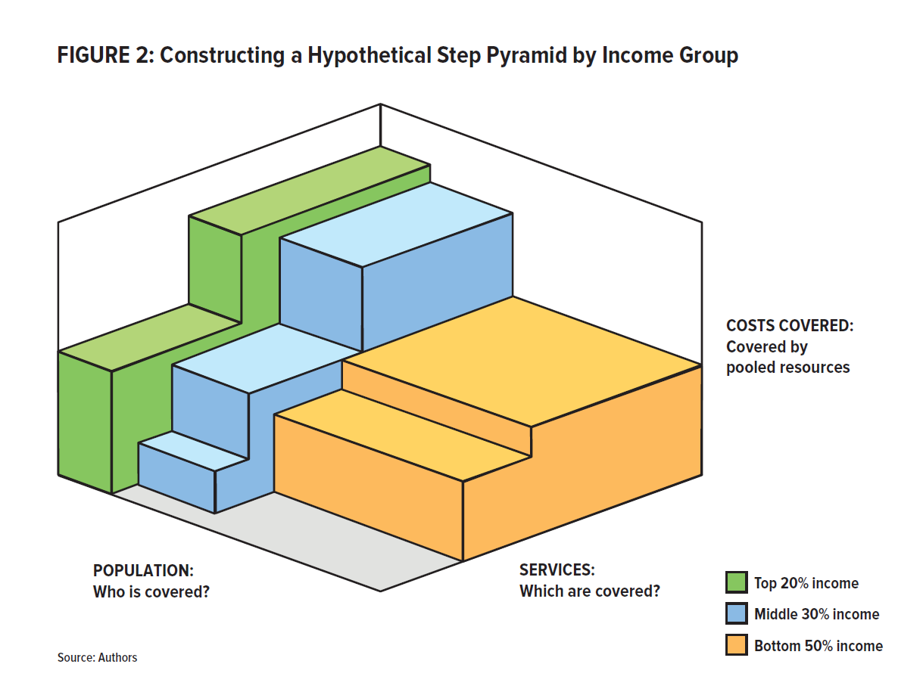
The Step Pyramid View of Coverage
A Hypothetical Step Pyramid by Income Group
COSTS COVERED:
Covered by pooled resources
POPULATION:
Who is covered?
SERVICES:
Which are covered?
Top 20% Income
Middle 30% Income
Bottom 50% Income
Source: Roberts, Hsiao, and Reich, 2015.

Slide 15
SPREADING RISK AND SUBSIDIZING THE POOR: POOLING OF RESOURCES

Slide 16
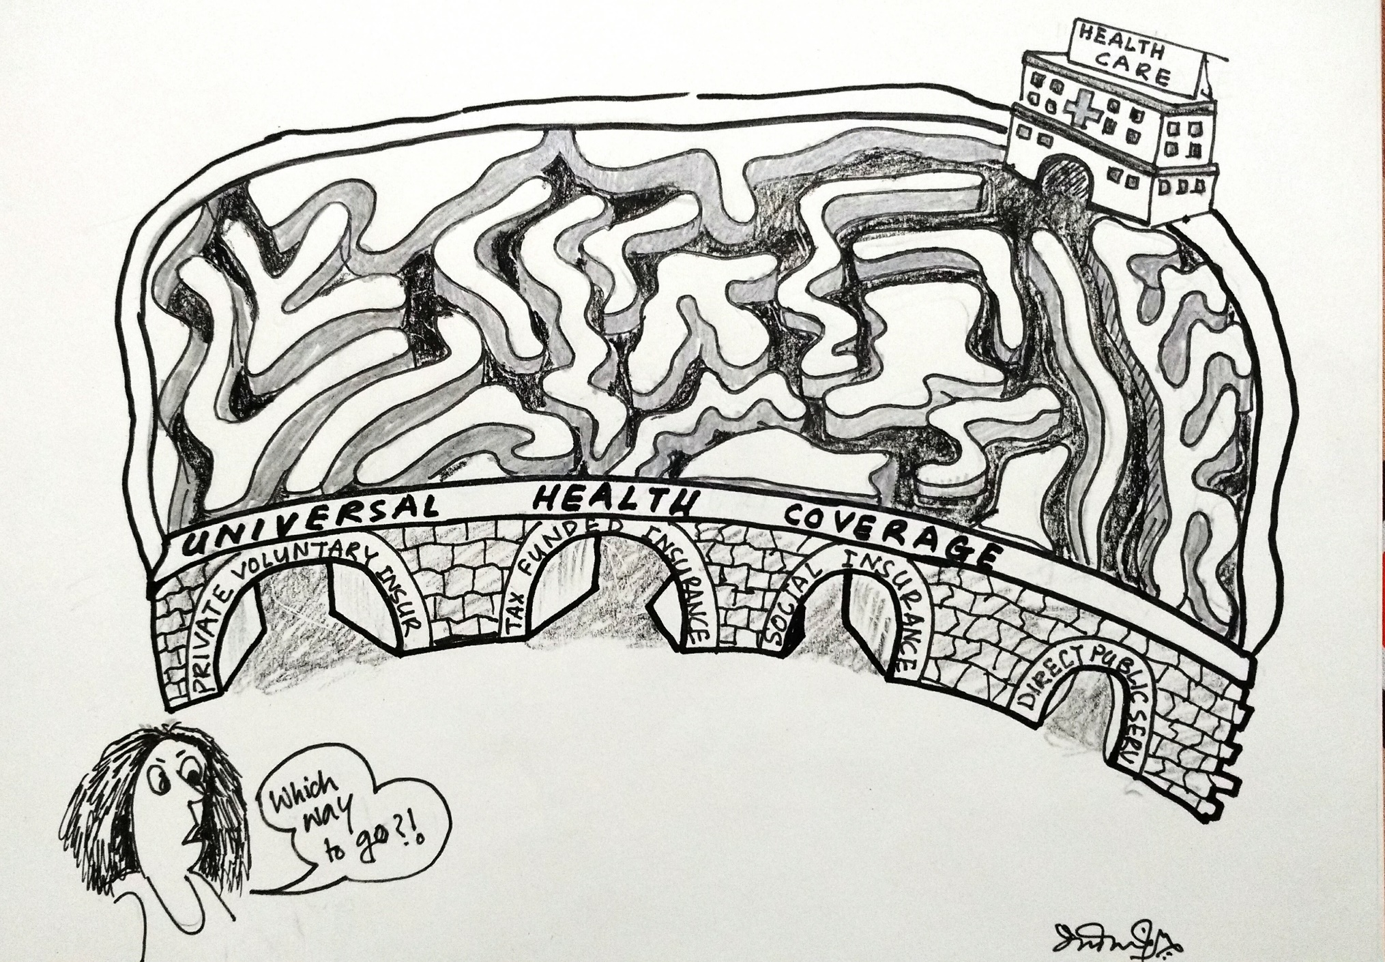
Various Avatars of UHC
General Govt. Revenue (Tax & Non-Tax) publicly provided
Social Health Insurance
Private Health Insurance
Community Health Insurance
Government Financed Health Insurance

Slide 17
History of Health Insurance in India
2018
PMJAY
2010-2017
Almost 20+ state schemes
2010
RSBY+ (HP) & Vajpayee Arogyashree (KN)
Employees State Insurance Scheme (1948) – Contributory & Formal sector workers
Central Government Health Scheme (1954) - Primarily for civil servants
Coverage by CGHS and ESIS very low still now, around 6 million (less than 5% of population)
Private sector participation started in mid-eighties with Mediclaim; It was privatized in 1999
2009
Kalaignar (TN)
2007
Rajiv Arogyashri (Andhra Pradesh)
2008
RSBY
Government Funded
Purchase health care from both
private and public institutions alike
Mainly limited to hospitalization expenses
Packages are identified and fixed package rate
Managed through Insurance agencies, government trusts
Voluntary participation for marginalized and poorer sections
2003
Yeshasvini (Karnataka)
1999
Privatization of Health Insurance
1986
Mediclaim
1954
CGHS
1948
ESIC

Slide 18
Strategic Purchasing
Purchaser-provider split
Strategic Purchasing: “a continuous search for the best ways to maximize health system performance by deciding which interventions should be purchased, how, and from whom”
Avoid “Fragmentation” of health systems
Principal-agent relationship

Slide 19
Principal agent relationship:
Difficult to specify preferences
Difficult to predict demand
Reliance on ‘agent’ for diagnosis, treatment and prognosis
  Physician
  Sector dominated by supplier

Slide 20
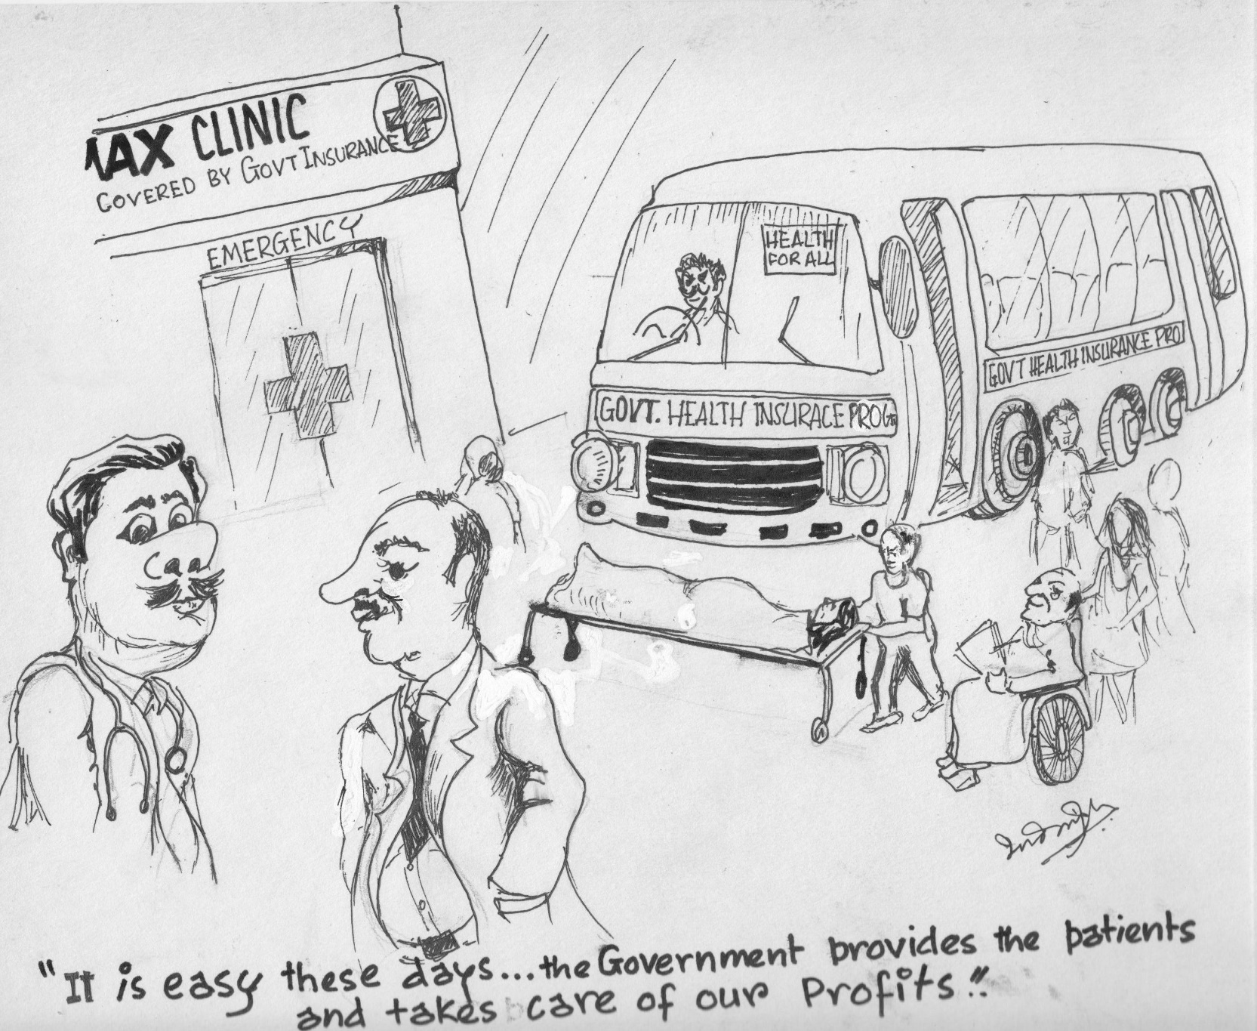
Guidelines by MoHFW, Government of India for Private Investments in setting up of Hospitals in Tier 2&3 cities and towns subsequent to PMJAY
The government will incentivise private sector in these cities to set up private hospitals by providing them land and funds and facilitating clearances in Tier II and Tier III cities.
The funding in the form of viability gap funding (VGF) will be upto 40%. In addition to VGF, the government will provide gap funding upto 50% of tax on capital cost.
Public Money and Private Profit

Slide 21
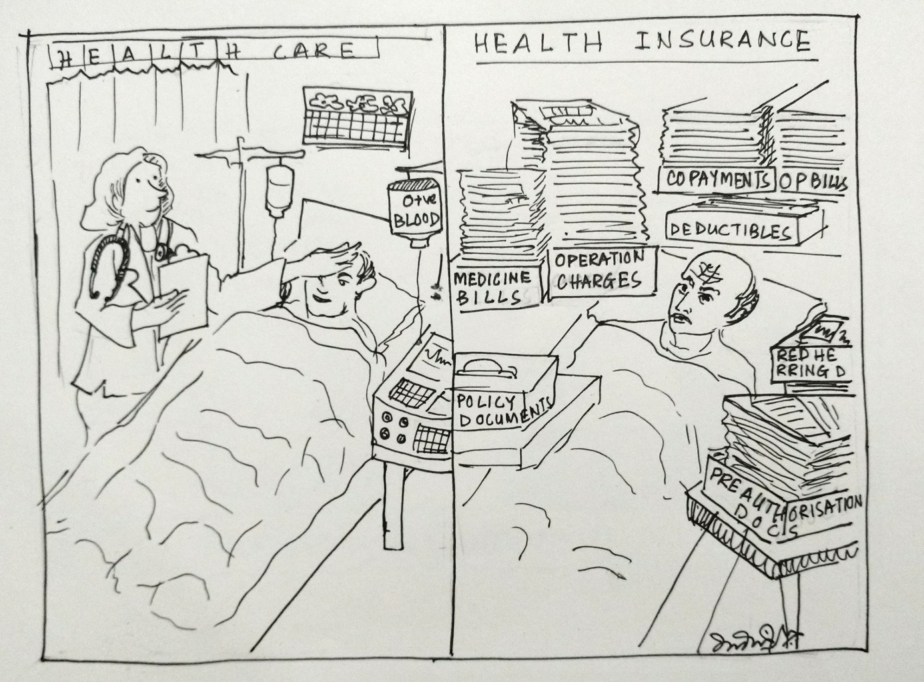
Care to Coverage

Slide 22
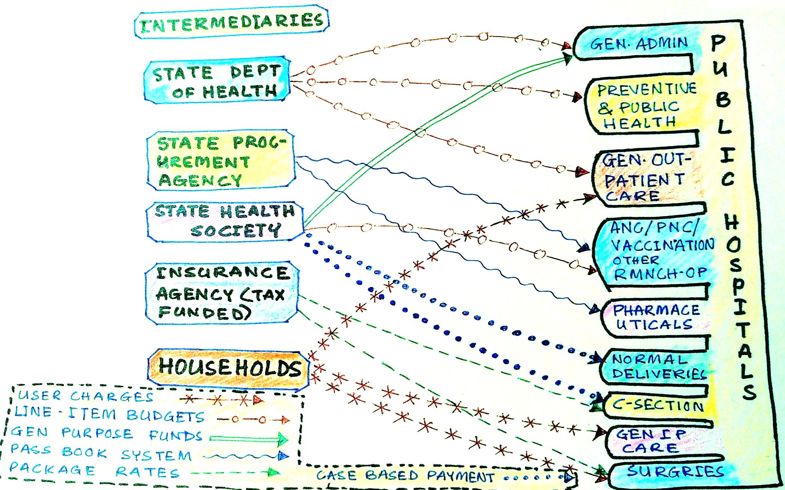
Blended payment mechanisms

Slide 23
Consequences of Principle agent relationship
Physician is an agent for the patient
He has monopoly
  Of information
  Of supply of treatment
    Barrier to entry in the professional arena
Monopoly power increases with uncertainty and complexity
  Super-specialty
Increasing cost of care

Slide 24
Market failures under insurance
Economies of scale
  Allocative inefficiency: monopoly premiums going higher than fair premium+ loading charges
  Single-payer, tax-financed public systems of insurance, one possible response to economies of scale, can generate technical efficiencies
  Reduces admin cost of collecting revenue, setting premium, purchasing care

Slide 25
Risk selection
Risk selection arises from informational asymmetries between the insured and insurers
Adverse selection, a process whereby low-risk individuals (LR) drop out of the insurance pool leaving only high-risk individuals (HR)
Individuals purchasing insurance have better information than does the insurer
If premiums are set at a level averaging both HR & LR then LR leaves
IF premiums are set higher another set would leave- Unsustainable
  Public subsidised insurance
  Compulsory groups based scheme

Slide 26
Cream-skimming
When insurers have better information on an individual's risk status than does the individual
An insurer generates higher profits by purposefully selecting lower risk individuals for coverage whose expected losses are below the premium charged
  Deductibles and
  co-insurance
Risk adjusted premiums
Regulations

Slide 27
Moral Hazard
Moral hazard refers to the likely malfeasance of an individual making purchases that are partly or fully paid for by others
He/she would overspend; i.e., s/he will use more services than s/he would were s/he paying for the medical care himself
Induced Demand

Slide 28
Monopolistic trends in private health care industry
Increasing penetration of corporate, for profit hospitals- mergers and acquisitions
Ownership being transferred from individual owned hospitals to corporate chains
Investments in share market, Engel Investments and other hot money
Pressure to make more profit- unnecessary, irrational care and higher prices
Increasing monopoly, cartels- greater referral linkages-greater control over prices- higher health care costs

Slide 29
Inadequate regulation
Partial price regulation under the GFIs: CEA doesn’t cover price regulation
Industry claiming prices are low- possibility of charging from patients- happening currently
A large part of the middle class is not covered by any insurance- chances of rise in health care costs- Cost shifting
Comprehensive price regulation is needed, irrespective of payment mechanism
Regulation alone fails to contain cost: need alternative public provisioning

Slide 30
Alternative framework: Public pathway
Expansion preventive care and public health services and primary care
Integration of secondary care through effective referral
Expand public procurement, decentralised distribution of essential commodities to curb health care costs
Regulation of both private and public sector- different terms- strong public system is most effective regulator of prices- examples of Thailand, Sri Lanka, Tamil Nadu
Innovations on provider payment mechanisms to improve performance of public providers
Improving governance and accountability mechanisms through peoples’ participation

Slide 31
