Slide 1
Community Engagement to Strengthen Public Health System and Access to Medicines: Trajectory and Possibilities
Jyotsna Singh

Slide 2
MSF and MSF Access Campaign
MSF – humanitarian medical organisation
Treatment provider in over 70 countries
Projects in India
Access Campaign – Policy Team
Founded in 1999 with money from the Nobel Peace Prize
Context – new patent regime kicked in after 1995
AIDS epidemic

Slide 3
Intellectual Property and Patents
WTO – Trade Related Aspects of Intellectual Property (TRIPS) in 1995
Patent term – 20 years
Monopoly
In 2005, India adopted product patent, in addition to previously existing process patent
However, did not allow evergreening

Slide 4
HIV, Tuberculosis and Hepatitis B & C
HIV – National AIDS Control Programme (NACP)
TB – Revised National Tuberculosis Control Programme (RNTCP)
HCV – National Viral Hepatitis Control Programme (NVHCP)
Public sector driven model
HIV/AIDS – nearly 90% registered in public sector
NVHCP – similar model
TB, especially DR-TB, increasingly public sector
Private: no regulation, don’t follow standard treatment guidelines
Antibiotic Resistance
new drugs under Conditional Access Programme

Slide 5
HIV
Active presence in National AIDS Control Organisation
Drug-users
Sex-workers
Trans persons
Shortages and stock-outs of kits and medicines
Community monitoring
Keeping track of the stock
Writing regular letters
Creating pressure

Slide 6
Hepatitis B and C
NVHCP – same groups as HIV
Same mode of transmission – Hep C and B
Launched in July 2019
First report from six states submitted in October
A major contribution – opposing patents

Slide 7
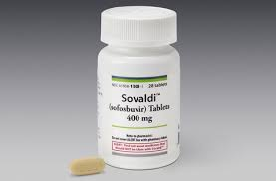
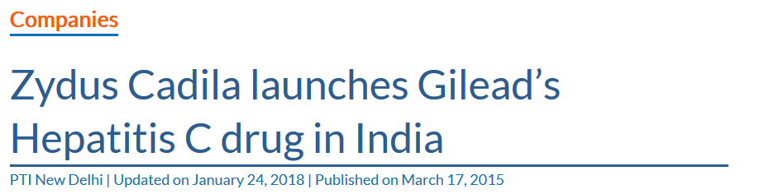
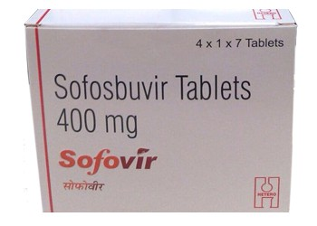
Sofosbuvir – Hepatitis C medicine
US multinational company Gilead
Cost at launch – US$ 84000 (roughly Rs. 60 lakhs)
First PIL for free treatment in Haryana High Court – Ratia town
DNP+ challenged in Delhi High Court
Voluntary License to 11 companies
Today the cost is in range of US$ 100 (roughly Rs. 6000)

Slide 8
Tuberculosis – Issues of engagement
Scale-up of new DR-TB drugs – Bedaquiline (Bdq) and Delamanid (Dlm)
Demand for compulsory licence – alternate producers
Shortages and stock-outs of medicines
Diagnostics

Slide 9
Court Case – Young woman from Patna
Govt. said cannot give Dlm to Shreya as they do not have the medicine
Jennifer Furin recommended in her affidavit
CS letter demanding registration of Dlm
Major issue: Otsuka did not work the patent. Letter demanded Govt Use license.

Slide 10
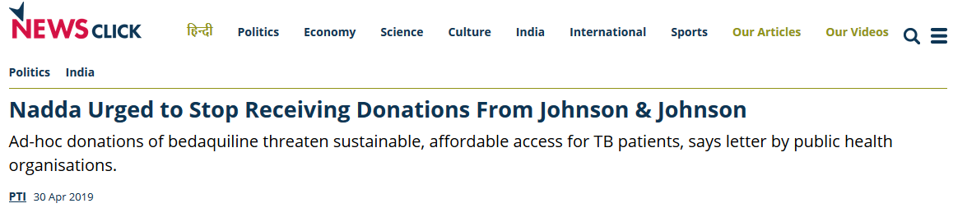
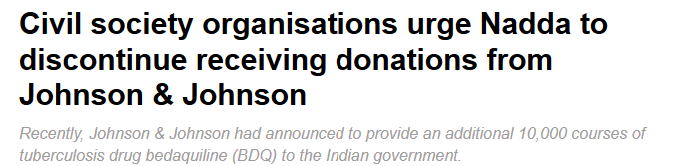
Calling out Donations
Donations weaken Govt’s capacity to negotiate
J&J – linking hip implants and Bdq

Slide 11
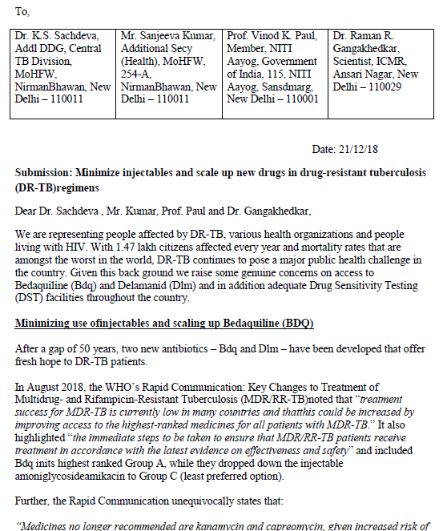
From older to new better regimens
From injectables to all-oral regimen
scale up of universal Drug Susceptibility Testing (DST)
ICMR to prioritize clinical trials for short-course oral M/XDR-TB regimens

Slide 12
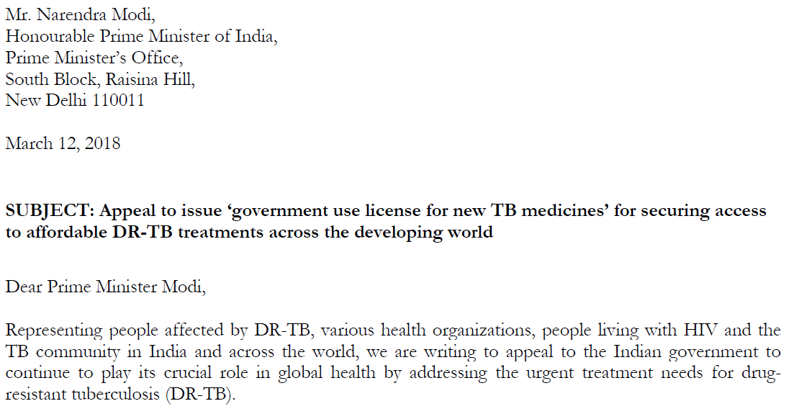
Fighting against patents
Endorsed by 93 national and international individuals and organisation
Access to new, patented TB drugs solely dependent on imports
Patents till 2023, Indian manufacturers hesitant
Reduce dependence on Voluntary Licensing
Alternate producers –> competition
Improve access globally

Slide 13
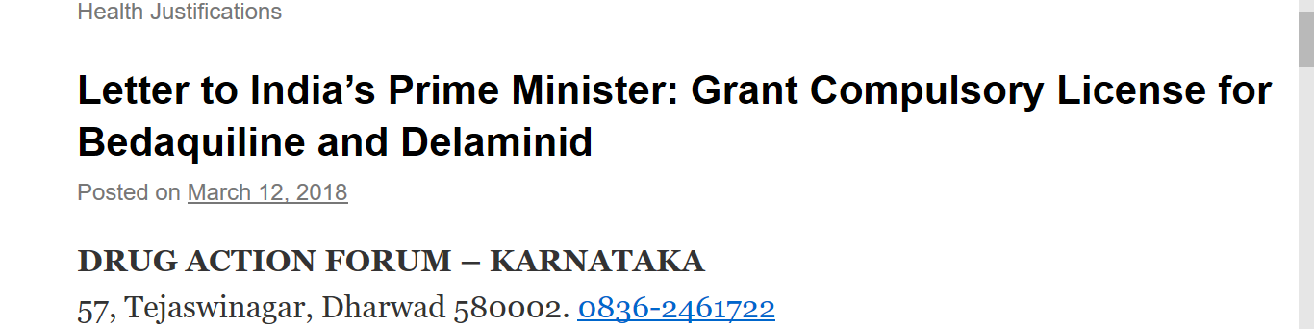
Fight against patents: Drug Action Forum Karnataka
Dr. Gopal Dabade from Drug Action Forum – Karnataka
CL for both Bdq and Dlm
Govt. Response – passing the buck

Slide 14
Opposition to evergreening
Patent by Johnson and Johnson for salt formulation for Bedaquiline
Not allowed under Indian Patent Law
Report by lawyers in 2018 – 72% bogus pharmaceutical patents between 2010-16

Slide 15
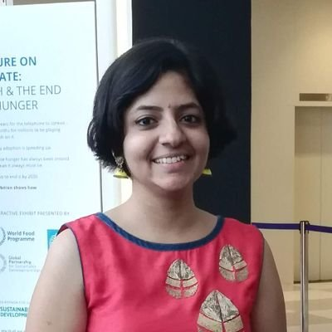

Opposition to evergreening
Filed by LC in Feb 2019 on behalf of two TB survivors with support from MSF

Slide 16
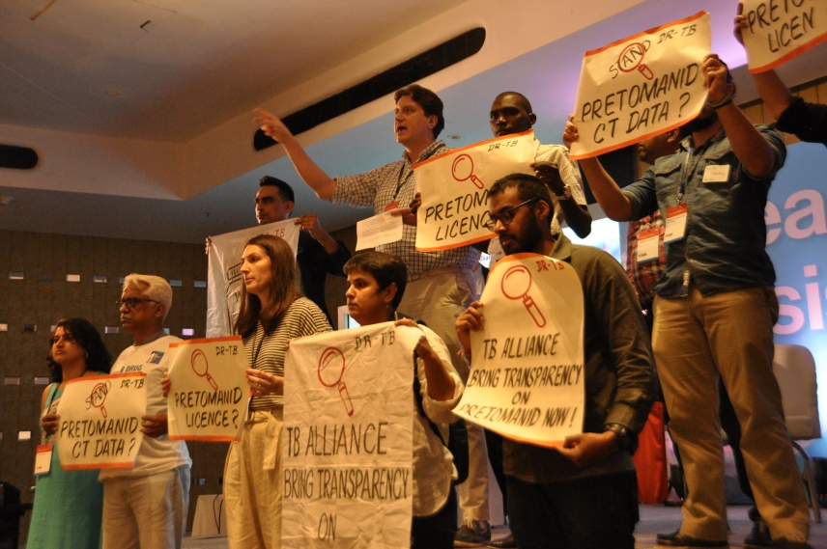
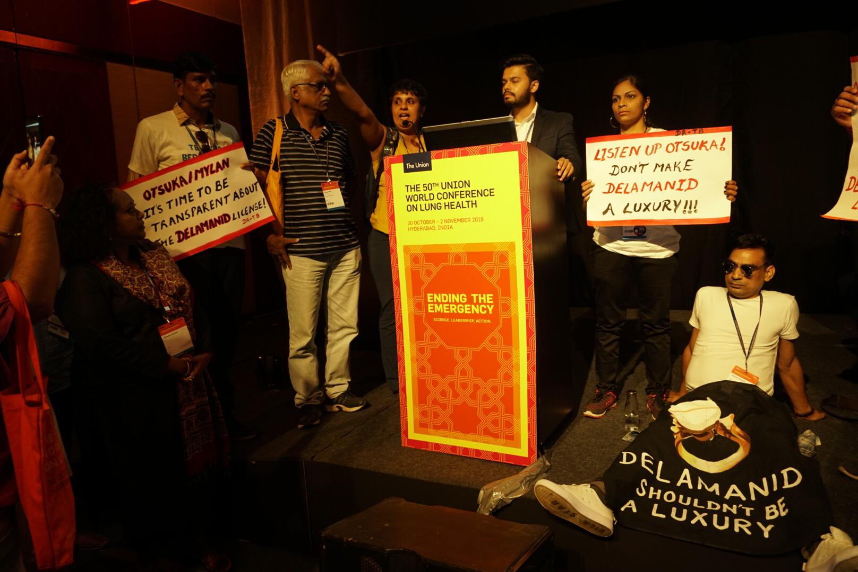
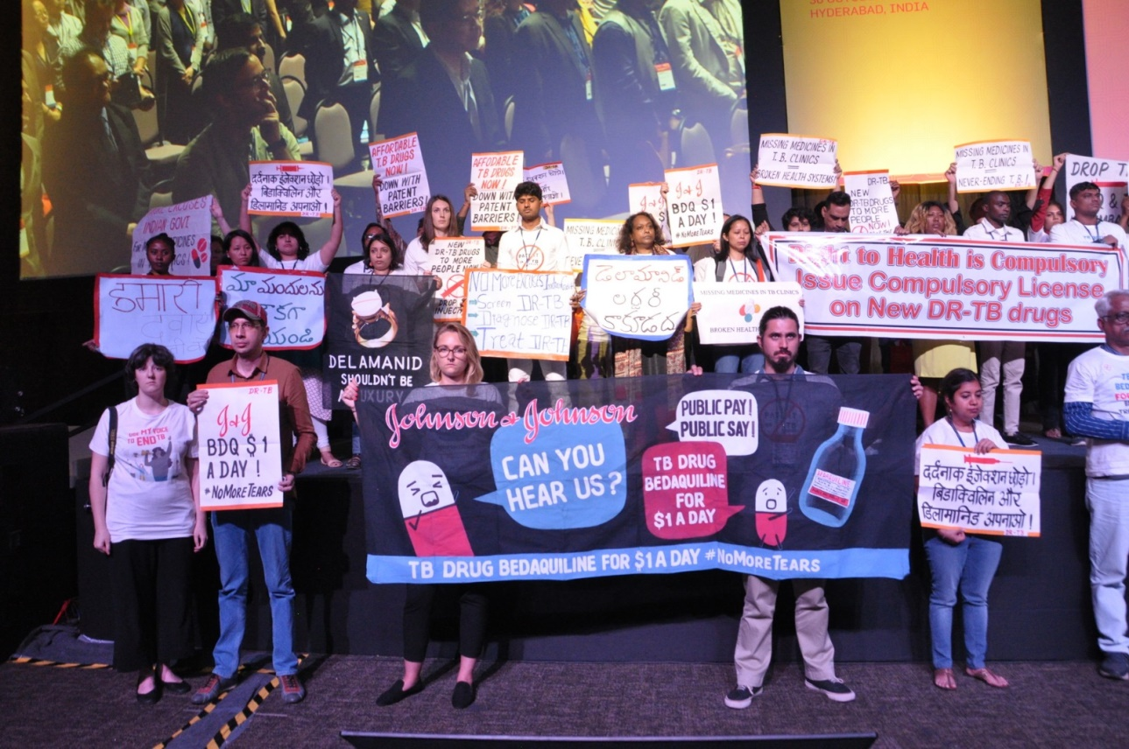

Slide 17
Slogans – Hindi and translation
1. टी. बी. के लम्बे इलाज से आज़ादी
T.B. ke lambe ilaj say Azaadi
Freedom from longer T.B. regimens
2. दर्दनाक इंजेक्शंस से आज़ादी
Dardnaak injections say Azaadi
Freedom from painful injections
3. दवाओं के पेटेंट्स से आज़ादी
Dawaon ke patents say Azaadi
Freedom from patents of medicines
4. दवाओंकी महंगाई से आज़ादी
Dawaon ki mehengai say Azaadi
Freedom from high prices of medicines
5. लालफीताशाही से आज़ादी
Laalfitashahi say Azaadi
Freedom from red-tapism
6. दवाओंके स्टॉकआउट्स से आज़ादी
Dawaon ke stock-outs say Azaadi
Freedom from stock-outs of medicines
7. हम चाहे टी. बी. से आज़ादी
Hum chahe T.B. say Azaadi
We want freedom from T.B.

Slide 18
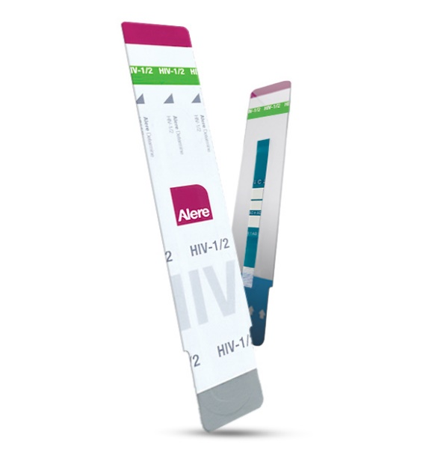
Possibilities of Engagement – Diagnostics
Crucial for strengthening pubic health systems, low-resource settings
Delayed test results – Loss to follow-up; antibiotic resistance
Play an important role in delivery of rational medication
WHO EDL
India’s EDL – We should engage
Rapid Diagnostic Tests (RDT)
govt’s malaria programme
CBNAAT – TB programme
New tests – TB-LAM

Slide 19
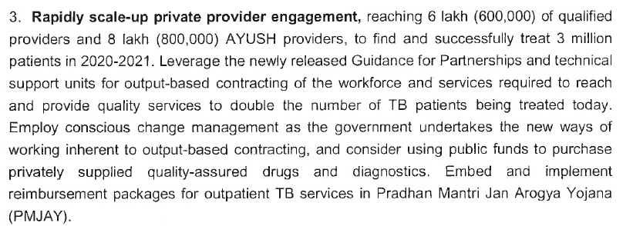
Possibilities of Engagement – Privatisation
Proposal to include TB outpatient care in Ayushman Bharat

