Slide 1
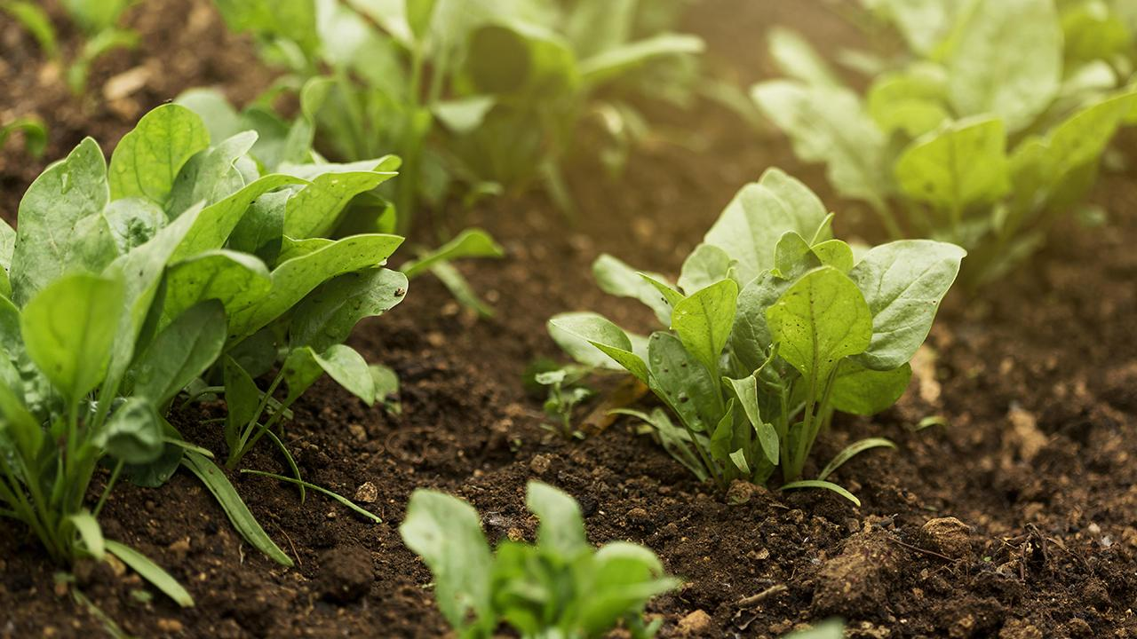

Issues of Agriculture in Andhra Pradesh
A study by JVV-AP

Slide 2
Agriculture has been the chief source of income for the state's economy. Andhra Pradesh is an exporter of many agricultural products.
Rice, sugarcane, cotton, chilli pepper, mango, and tobacco are the local crops.
Agriculture plays an important role in the livelihoods of people as 70% of the population live in rural areas and depend on agriculture and related livelihood opportunities.
Close to 19% of state GDP is from Agriculture & Horticulture.

Slide 3
Major Problems in AP
Over Usage of pesticides
01
Tenant Farmer's
04
Over Burden by increased prices for pesticides & Urea
MSP for all crops
02
05
Extension of flood relief to millet crops & virus affected crops
Shortage of Godowns & Coldstorages
03
06

Slide 4
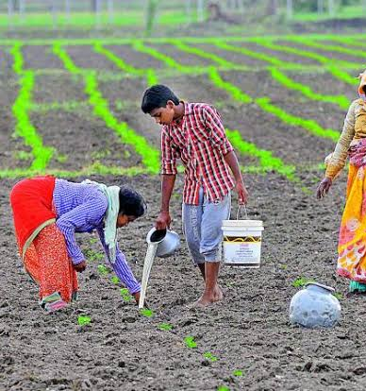
Tenant Farmer's
According to the 70th round of the NSSO report, the state has 35.7% tenant farmers, while the national average is 10.4%.
In this backdrop, the state also has farmer suicides at an extreme level, which increased from 664 in 2018 to 1029 in 2019, as per the National Crime Records Bureau (NCRB)
Rythu Bharosa scheme
Failure of govt in the transfer of benefit to tenant farmers.

Slide 5
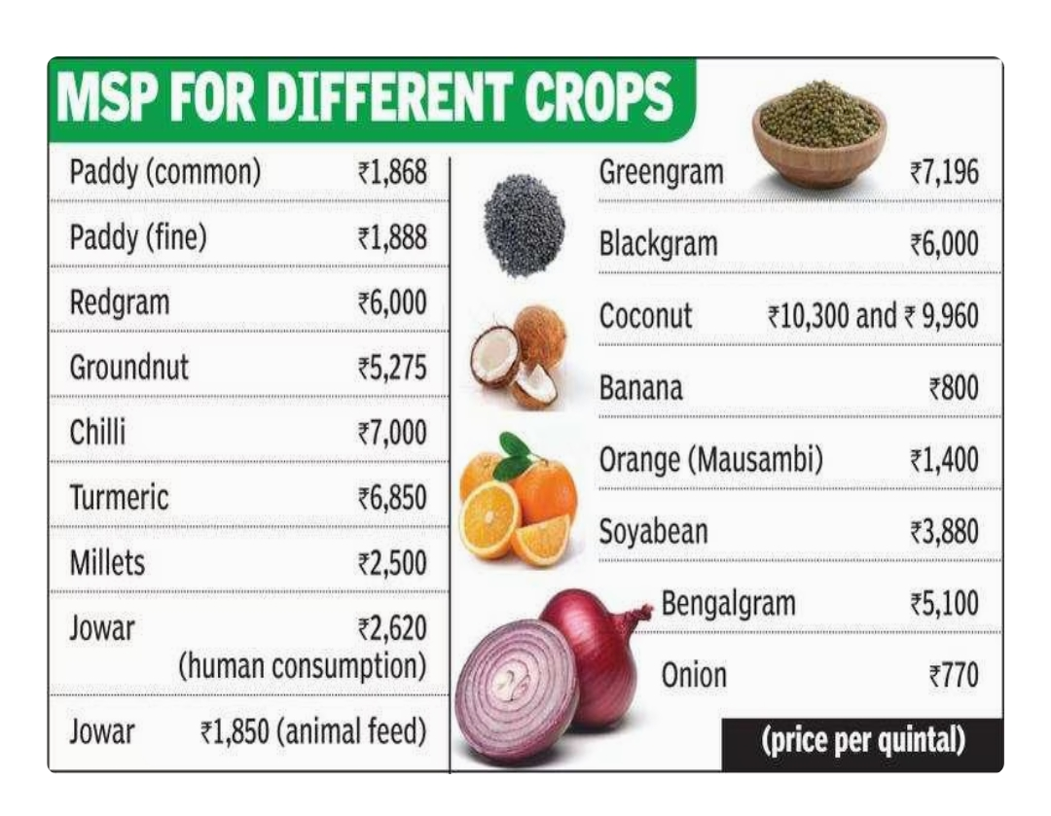
Minimum Support Price
The government promised to pick up stocks from growers if they fail to get MSP for their crops from private traders.
Poor implementation of the scheme
False promises lead to over production of paddy in both AP & TS.
The Centre worked out the MSP based on the (A2 + FL) +50 formula, which is much lower than the C2 cost.

Slide 6
Over Usage of pesticides & Insecticides
Environment
Water and soil Contamination
Direct impact on Humans
Effect on soil fertility

Slide 7
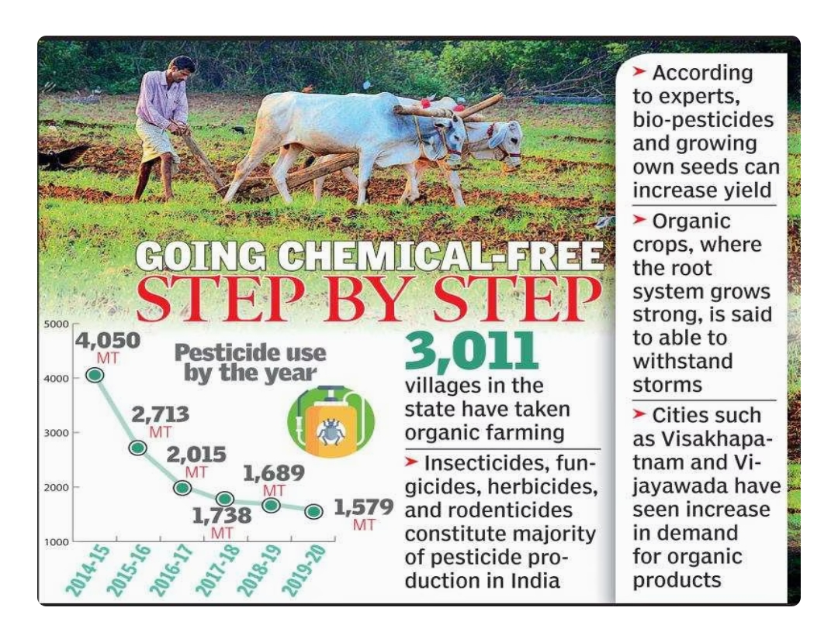
Over burden by increased prices
Pesticides
Urea & DAP
Prices of key insecticides and pesticides have increased 5-15 per cent over the past year
Shortage of urea & DAP lead to buy at higher prices in june 2021.

Slide 8
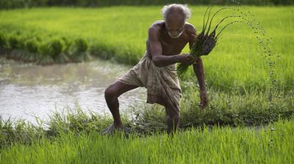
Extension of flood relief to millet crops & virus affected crops
With no financial assistance being released by the Centre for crop damages due to heavy rains last November, the AP government will release nearly Rs 542 crore as input subsidy to the affected farmers soon to help them resume cultivation of crops.
Crops being raised in about 9.26 lakh acres suffered damages due to heavy rainfall and floods in both the rabi and kharif seasons with an estimated production loss of 6.65 lakh metric tonnes.
Over 80% of chilli production damaged by new unidentified virus in guntur district, AP. Govt needs to extend the relief to the farmers.

Slide 9
Shortage of Godowns & Cold storages
Capacity
Additional Charges
Needs 3X Capacity as increased in production
incurring additional expenditure on transportation and rentals for cold storage charges in other places
Rental Charges
Post Harvest Losses
Many facilities owned by private owners & they're charging 45rs per bag per year.
incurring heavy post-harvest losses on fruits, agriculture and other products such as red chillies

