Slide 1

75 Years of independence & agriculture training & webinar, agriculture desk, aipsn
Future of sustainable agriculture – role of THE psm
RAGHUNATH.TP
PONDICHERRY SCIENCE FORUM
13 APRIL 2022

Slide 2
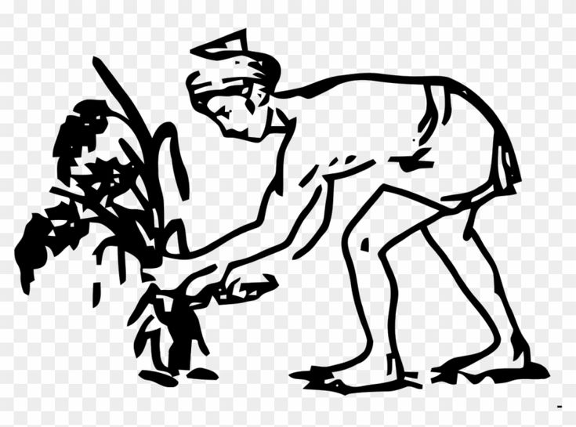
Merits and demerits of GR – Already dealt in the AIPSN Paper.
GR did not solve the poverty / malnutrition (India 101 / 160 in world hunger index – 2021)
Since the GR , worldwide agriculture has been characterized by a typical top–down approach.
The degree of autonomy, creativity, and responsibility of farmers has been limited by the continuous external inputs of chemicals, machinery, advice, subsidies and knowledge.
Notes:
From the so-called Green Revolution, started in the 1950s, to the current period of innovations based on digital devices, worldwide agriculture has been characterized by a typical top–down transfer of technology. In this pervasive paradigm, technology is developed in the controlled environment of universities and research stations, passed on to agricultural advisors and then to farmers, who consume and apply it ([18]: 67). Technology is perceived as a commodity delivered to farmers, who have little control over its development and management

Slide 3
They have also lost control over essential resources due to the concentration of power in the mechanical, seed, chemical, processing, and distribution industries.
GR- Second Phase?
With the introduction of advanced techniques, such as genetic engineering, nanotechnology, precision agriculture, sensors, satellites, and robotics, innovation has become increasingly sophisticated and its development even more disconnected from farmers

Slide 4
THE ALTERNATIVE
Agroecology represents an innovative paradigm of agriculture in which external inputs are minimized, and the assets of the farm are greatly valued.
Agroecological production relies on the farmers’ direct management of resources and on their active engagement in the agricultural knowledge and innovation system
A systemic ecological approach is adopted in order to understand the relations between living organisms and their environment. This fosters the processes that move the agroecosystem closer to a natural, mature, relatively stable, and self-sustaining ecosystem, able to maintain productivity without external inputs

Slide 5
AE is “the practice of science with people” and stress that participation is at the core of any single process.
Agroecology implies the promotion of practices that
fit the local contexts in which they are implemented,
foster the autonomy and skills of the communities involved (as is the case with the participatory research network
profit from locally produced resources, included local opinions regarding sustainability.

Slide 6
ROLE OF PSM – NETWORK OF RESEARCHERS (KNOWLEDGE NETWORK OF EXPERIMENTER FARMERS)
“Farmers are researchers by nature, but with a great limitation: they don’t bother taking notes. They are not interested in writing, so they don’t bother publishing the discoveries coming from their ability to adapt during agronomy activities.
Can PSM bring in the missing element ?
To bring together innovation actors:
farmers, advisers, researchers, businesses, NGOs, and others.
The collaboration among them would make the best use of complementary types of knowledge, so as to achieve the co-creation and diffusion of solutions and opportunities that would be readily implementable in practice.

Slide 7
Agroecology aims not only to realize low-input farming systems, based on the exploitation of natural processes, but it also focuses on social–economical aspects, such as those related to human value, knowledge sharing, and equality in power distribution among the actors of the food supply chain.
There is nothing wrong in adopting the use of external products which should be useful during the first period of transition to achieve a balance within the agroecosystem.
However, in the real life of farms, this is often interpreted in a misleading way, and organic farming could follow the “input substitution approach” by replacing inputs permitted in conventional farming with others permitted in organic farming, which are not always very eco-friendly without changing the underlying crop management approach.

Slide 8
As PSM activists, we need to first “learn” what is Agroecological Farming, and only after that we can be the catalysts in making Agriculture to be farmer-friendly and remunerative again by creating AE Farmer/Researcher networks.
Results come from individual experience, but experience comes from the exchanges among the farmers, who experiment with different techniques, each on their own land, each with their entrepreneurial approach. The mixing, discussion and reflection with the researchers brings about improvements in the sector. Everyone has something to give and something to receive—this is the true strength of a network
The AIPSN Agri Desk can initiate the process as this can be a true people’s science movement.
Thanks for the opportunity

